Slide 1

PITCH TEMPLATE

Slide 2
EV CHARGING NETWORK CHALLENGE
Team Disruptors

Slide 3
01
INTRODUCTION

Slide 4

ABOUT ME
I am Chirag Hegde, an undergraduate student pursuing my B. Tech in Electronics and Communication Engineering from the Indian Institute of Technology, Guwahati, India. I am passionate about technology and the role it plays in solving real life problems. I have won several hackathons and I love participating in them as they provide a competitive pretext to a problem at hand, encourage critical thinking and expose me to new technologies!

Slide 5
INSPIRATION
Given the non-renewable nature of fossil fuels and the increasing rate of global warming, it is the need of the hour to move to more sustainable sources of energy like electricity.
The EV sector requires accurate and reliable planning of the charging stations along with robust demand predictions to meet the ever-growing demand of electrical vehicles and encourage adaptation.

Slide 6
PROBLEM STATEMENT
Given :
The demand for the EV charging stations for 4096 regions over the years of 2010 to 2018
Existing EV charging infrastructure for 100 public parking locations for the year 2018.
Required :
Forecast demand and optimize EV infrastructure for year 2019 and 2020.

Slide 7
02
METHODOLOGY

Slide 8
PROPOSED SOLUTION
01
STEPS
02
Demand Forecasting
Optimization Modeling
Using the provided demand data from the years 2010-2018, we predict the EV charging demand for the years 2019 and 2020.
Once the demand forecasts are made, we use our optimization model to calculate the optimal required EV chargers and demand-to-supply mappings.

Slide 9
DEMAND FORECASTING
To predict the EV charging demands for 2019 and 2020, we propose a solution using curve-fitting on the given data points for each demand location.
The objective function for the curve is chosen so as to avoid over-fitting on the data and under the assumption that the demand will show a general increasing trend over the years.

Slide 10
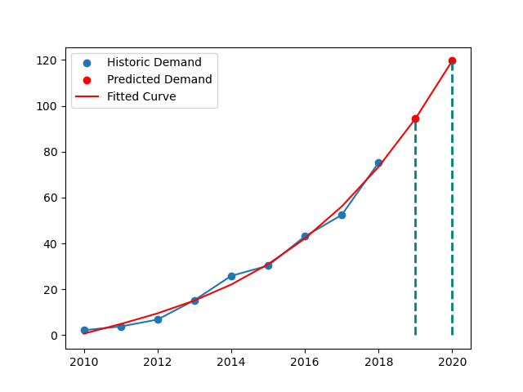

DEMAND FORECASTING
Chosen Objective Function
$$a.x^{3}+bx^{2}+cx+d$$

Slide 11
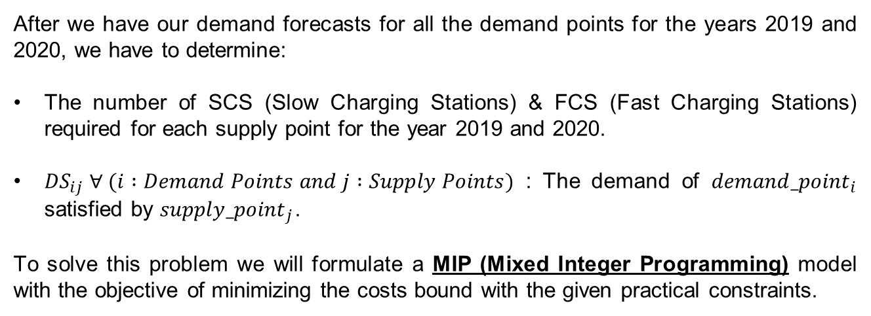
OPTIMIZATION MODELING
After we have our demand forecasts for all the demand points for the years 2019 and 2020, we have to determine:
The number of SCS (Slow Charging Stations) & FCS (Fast Charging Stations) required for each supply point for the year 2019 and 2020.
${DS}_{ij} ∀ (i :Demand Points and j :Supply Points)$ : The demand of ${demand_point}_{i}$ satisfied by ${supply_point}_{j}$.
To solve this problem we will formulate a MIP (Mixed Integer Programming) model with the objective of minimizing the costs bound with the given practical constraints.

Slide 12
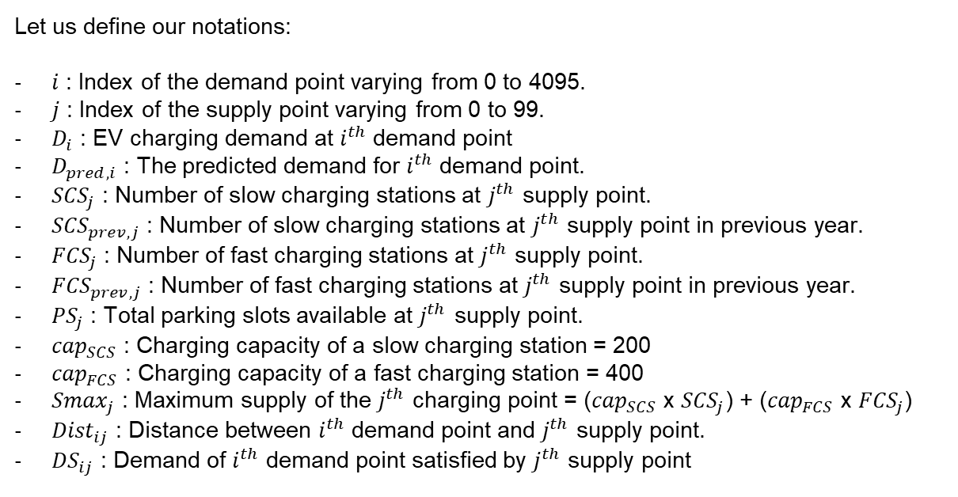
OPTIMIZATION MODELING
Let us define our notations:
$i$ : Index of the demand point varying from 0 to 4095.
$j$ : Index of the supply point varying from 0 to 99.
$D_{i}$ : EV charging demand at $i^{th}$ demand point
$D_{pred, i}$ : The predicted demand for $i^{th}$ demand point.
${SCS}_{j}$ : Number of slow charging stations at $j^{th}$ supply point.
${SCS}_{prev, j}$ : Number of slow charging stations at $j^{th}$ supply point in previous year.
${FCS}_{j}$ : Number of fast charging stations at $j^{th}$ supply point.
${FCS}_{prev, j}$ : Number of fast charging stations at $j^{th}$ supply point in previous year.
${PS}_{j}$ : Total parking slots available at $j^{th}$ supply point.
${cap}_{SCS}$ : Charging capacity of a slow charging station = 200
${cap}_{FCS}$ : Charging capacity of a fast charging station = 400
${Smax}_{j}$ : Maximum supply of the $j^{th}$ charging point = (${cap}_{SCS}$ x ${SCS}_{j}$) + (${cap}_{FCS}$ x ${FCS}_{j}$)
${Dist}_{ij}$ : Distance between $i^{th}$ demand point and $j^{th}$ supply point.
${DS}_{ij}$ : Demand of $i^{th}$ demand point satisfied by $j^{th}$ supply point

Slide 13
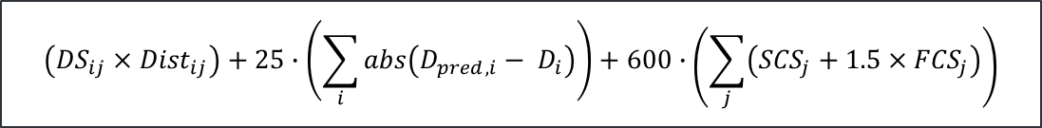
OPTIMIZATION MODELING
The cost function that is to be minimized
$$\left({DS}_{ij}×{Dist}_{ij}\right)+25∙\left(\sum_{i}{abs\left(D_{pred, i}− D_{i}\right)}\right)+600∙\left(\sum_{j}{\left({SCS}_{j}+1.5×{FCS}_{j}\right)}\right)$$

Slide 14
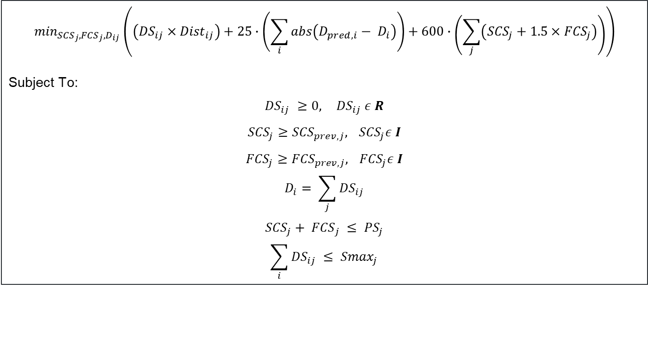
OPTIMIZATION MODELING
Thus the final model looks like,
$$\min_{{SCS}_{j},{FCS}_{j},D_{ij}}\left(\left({DS}_{ij}×{Dist}_{ij}\right)+25∙\left(\sum_{i}{abs\left(D_{pred, i}− D_{i}\right)}\right)+600∙\left(\sum_{j}{\left({SCS}_{j}+1.5×{FCS}_{j}\right)}\right)\right)$$
Subject To:
$${DS}_{ij} ≥0,{ DS}_{ij} ε R$$
$${SCS}_{j}≥{SCS}_{prev, j},{ SCS}_{j}ε I$$
$${FCS}_{j}≥{FCS}_{prev, j},{ FCS}_{j}ε I$$
$$D_{i}= \sum_{j}{{DS}_{ij}}$$
$${{SCS}_{j}+ FCS}_{j} ≤ {PS}_{j}$$
$$\sum_{i}{{DS}_{ij}} ≤ {Smax}_{j}$$

Slide 15
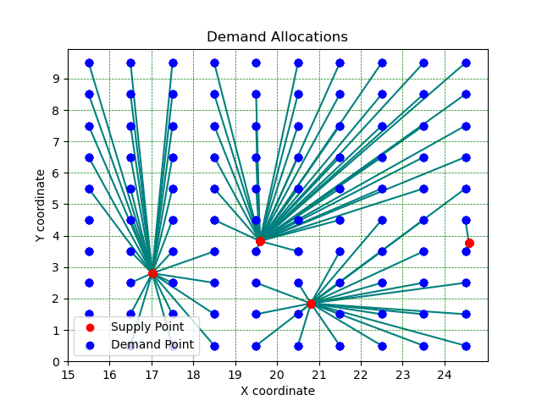
RESULTS
Our optimization model generates the optimal demand-supply allocation matrix and the optimal number of SCS and FCS charging stations.

Slide 16
FRAMEWORK AND STACK
01
03
Tech Stack (Python)
Scipy
02
Matplotlib
For Curve Fitting
For Visualizing Data
Gurobi
For Optimization Modelling

Slide 17
PERFORMANCE DETAILS
Demand Forecasting
Optimization Model Set-Up
Optimal Solution Finding
01
02
03
6.12 sec
35.24 sec
9.78 sec
TOTAL TIME TAKEN
51.1 sec
The program was run on a machine with an Intel Core i5 9th Gen processor and 8GB of RAM

Slide 18
RESULTS ACHIEVED
Low cost
Leaderboard Score (2019)
76.1316
Objective Cost (2019)
3,978,066

Slide 19
03
DEPLOYMENT & SCALABILITY

Slide 20
SCALABILITY & ROBUSTNESS
The Optimization Model is formulated in a way to focus on the minimization of the cost function irrespective of the distribution of the demand and supply locations.
The current problem has 100 supply points and 4096 demand points. The model provides the solution in 51.1 seconds.
The bottleneck for the solver is the speed of the Python language. This can be overcome by migrating the Optimization Modeling to better performing languages like C++, Java, MATLAB or R.

Slide 21
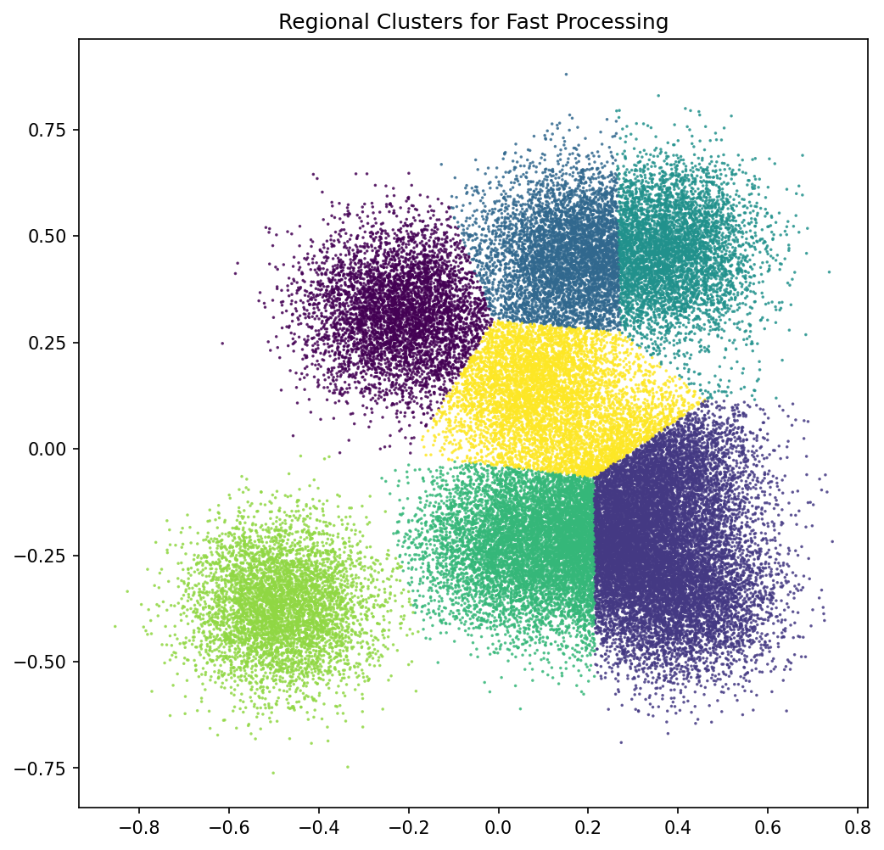
SCALABILITY & ROBUSTNESS
For an exponential increase in the supply and demand points, we can divide the problem into smaller sub problems by applying Clustering Algorithms to find clusters and solve these sub problems concurrently.

Slide 22
INFRASTRUCTURE REQUIREMENTS
CPU
AND
RAM
MIP Solvers benefit from high CPU speeds
Low-latency, high-bandwidth memory.
The leaderboard submission was obtained in 51 sec on a machine with Intel i5 9th Gen CPU and 8 GB of RAM.

Slide 23
THANK YOU

